Slide 1
Engine separation from the aircraft
Hazardous or catastrophic?
Consequences?

Slide 2
An example: 1 April 1993, Anchorage, loss of engine #2 in flight: safe landing (fuse pin)

Slide 3
Elal 1862 A’dam 1992: a separated engine

Slide 4
Engine #3 separated and took out #4, damaged LE flaps (2 generators, 2 pneumatic systems, 2 hydraulic pumps)

Slide 5
The way in which an engine may separate from an aircraft, wing or fuselage, is difficult to predict. Separation can result from
Structural failure of the engine suspension system (in the past fuse pin designs failed quite frequently)
Uncontained engine rotor failure ‘cutting’ structural parts
In the past ‘the clean engine separation scenario’ existed
This means the engine separation is supposed ‘to be controlled’ and follows certain assumptions

Slide 6
Separation scenario is complex, due to effects of:
Power on or off, e.g. at the moment of the event does the engine still produce thrust or not;
Engine fan rub, engine seizure loads;
Gyroscopic effects of the engine;
Aerodynamic effects of the engine/pylon combination (the pylon forces can be enormous at for instance 250 knots or higher);
Airplane sudden movements and inputs

Slide 7
The engine, when separating, may
Move sideways
Move upward (over the wing?)
Combinations of directions
Not always follow the design logic that we supposed it to follow
Failure with ‘thrust ON’ is probably more complex than failure with ‘no thrust’ (there is a thrust vector)
‘No thrust’ could be assumed when an uncontained failure cause the engine to separate: the engine stops producing thrust shorty after the failure

Slide 8
An engine is missing: damage is limited

Slide 9
Leading edge damage

Slide 10
Missing leading edge slat

Slide 11
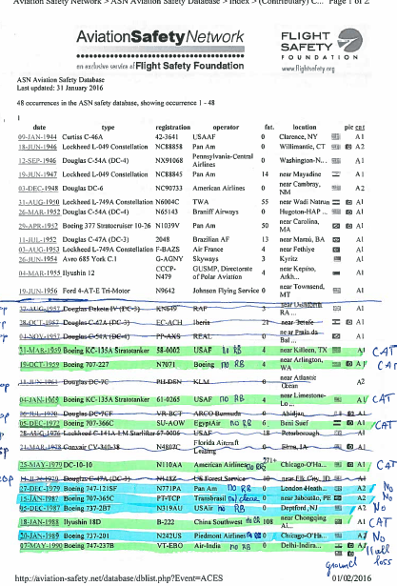
Aviation safety network database: engine separations (prop excluded, only turbine engine after 1959)

Slide 12
summary
22 engine separations found after 1959 on turbine engine aircraft
8 were catastrophic
21 caused by structural failure (mostly fuse pin failure related)
No CAT events on twin engine aircraft
CAT events on 4 engine aircraft
An engine on 1 wing can take it out the other engine on the same wing in a sideward move
All multiple engine separations were catastrophic on quads (engine on same wing separated)

Slide 13
QUADS
QUADS:
19 known events on 4 engine aircraft with classical configuration (wing mounted engines): 8 ended CAT, all designs used fuse pins. This is 8/19 x 100% = 42%.
Of those 8 CAT, 5 multiple engine separations, 3 single engine separations. Of the CAT engine separation on 4 engine aircraft 5 / 8 x 100% = 62.5 % were multiple engine separations.
11 out of 19 single separations on ‘quads’ did not end catastrophic.

Slide 14
TWINS
2 known events on 2 engine aircraft with classical configuration (wing- mounted engines): 0 (zero) ended CAT, both design used fuse pins

Slide 15
The catastrophic ones
:
Engine mount type | Aircraft Type | Number of engines | How many separated? | Failure with thrust on or due to UERF? | observation
Fuse pin | BOEING B747 | 4 | 2 events with 2 separated engines | All with thrust on
Fuse pin | BOEING B707 | 4 | 1 event 3 engines 1 event 1 engine | All with thrust on
Fuse pin | DOUGLAS DC-10 | 3 | 1 event 1 engine | All with thrust on
Fuse pin | BOEING KC-135A | 4 | 1 event 1 engine 2 events 2 engines | All with thrust on | In the single separation the engine struck the tail
 |  |  | Total 8 events on quads out of 19 ended catastrophic = 42% | All with ‘thrust on’
 |  |  | In 5 of 8 cases there was a multiple engine separation = 62,5 % |  | In many case it means a separation of 1 engine caused the separation of another engine on the same wing
 |  |  | In the remaining 3 of 8 single engine separations the resulting total damage caused the crash |  | Total damage can be tail strike or wing damage (engine rotates over the wings and caused slat/flap damage) and take the aircraft out
 |  |  | All the CAT separation used a design with fuse pins

Slide 16
The following has changed since 1992
The fuse pin-type of designs were modified on the Boeing 747 fleets
The ‘clean-engine separation concept’ ceased to exist

Slide 17
EASA proposal to be used for FHA classification or in rotorburst analysis (failure in flight)
Classification of engine separation, non –fuse pin design | Separation caused by structural failure with ‘thrust on’ (assuming engine keeps producing thrust until being fully separated) | Separation caused by UERF: (assumed engine stops producing thrust at the very moment of the engine failure)
4 engine aircraft classical configuration with wing mounted engines | Depending on the design but worst case CAT, since the possibility exists that another engine will be taken out (>= 50%), or damage resulting from separation will result in CAT. There is no ‘clean separation’ in this case | Thrust stops at moment of separation. CAT, also here the risk exists of resulting damage mostly caused by the risk of taking out another engine. Engine side ward motions most probably not controllable.
2 engine aircraft classical configuration with wing mounted engines | Depending on design, but potentially CAT, since the effect of thrust can cause further damage which is difficult to control (tail strike or flaps/slats damage) | Thrust stops at moment of separation, however the possibility of taking out the other engine on the other wing is low. No engine on the same wing. Risk of hitting the tail is low (depending on design). HAZ
Fuselage mounted engines | Probably CAT due to c.g. control problems, tail strike issues | Also probably CAT due to c.g. and controllability issues
Failure on ground | CAT | CAT

Slide 18
If engine separation due to UERF would be CAT
It needs to be in the quantitative UERF analysis
It may give a significant contribution in the analysis
Unknown if applicants have thought about that
A reduction factor on ‘quads’ could be discussed

